Slide 1

Identifying Trends and Possible Emerging Skills
By Luke Adeosun
02 December 2024

Slide 2



OUTLINE
Executive Summary
Introduction
Methodology
Results
Visualization – Charts
Dashboard
Discussion
Findings & Implications
Conclusion
Appendix

Slide 3

EXECUTIVE SUMMARY
As the global IT sector is continuously changing technologies , to remain competitive , it important regularly analyzes data to help identify future skill requirements
Collecting data from various sources
Job postings
Training portals
Surveys
The data showed that Javascript is currently the most popular programming language and predicted to remain so in the future. MySQL is currently the most worked with database, but Postgre SQL is projected to take that spot
Looking into the present demand landscape , dashboards were used to better highlight the followings areas ; Current Technology Usage, Future Technology Trends & Demographics

Slide 4

INTRODUCTION
The focus of this report to offer an insight into emerging skills and technologies. Highlighting current and future trends.
The following questions were investigated:
What are the top programming languages in demand?
What are the top database skills in demand?
What are the popular IDEs?
The target of these findings are highly experienced IT consultants/professionals and those interested in changing technologies and remaining competitive within the industry.

Slide 5

METHODOLOGY
Data Collection- by scraping internet web sites and accessing APIs to collect data in various formats like .csv files, excel sheets, and databases. This included job availability across diverse locations for different technologies which was gathered from Github Jobs API on Python.
Data Wrangling - or Munging is a process in which we clean up the data set and make it ready for data analysis. By performing the following tasks:
Identify duplicate rows in the data frame.
Remove duplicate rows from the dataframe.
Find the number of missing values for all columns.
Find the value counts for the column "Employment".
Normalize the data using two existing columns.
Exploratory Data Analysis-After cleaning the dataset, this was carried to find distribution of data, presence of outliers and also determine the correlation between different columns in the dataset. A new dataframe was created for further analysis.
Data visualization –Visualizations were created with the Stack Overflow Developer Survey 2019 dataset. Such as histograms, scatter plots , bubble or boxplot, pie chart, bar chart, and stacked chart . To effectively show the distribution , correlations ,medians and counts within the dataset.
Dashboard- Kaggle survey 2023 data was used to create the Google Looker Studio dashboard tabs. That cover Current Technology Usage, Future Technology Trends & Demographics. Giving insights into the top languages , platforms , databases , web frameworks and demographic information.

Slide 6


Slide 7
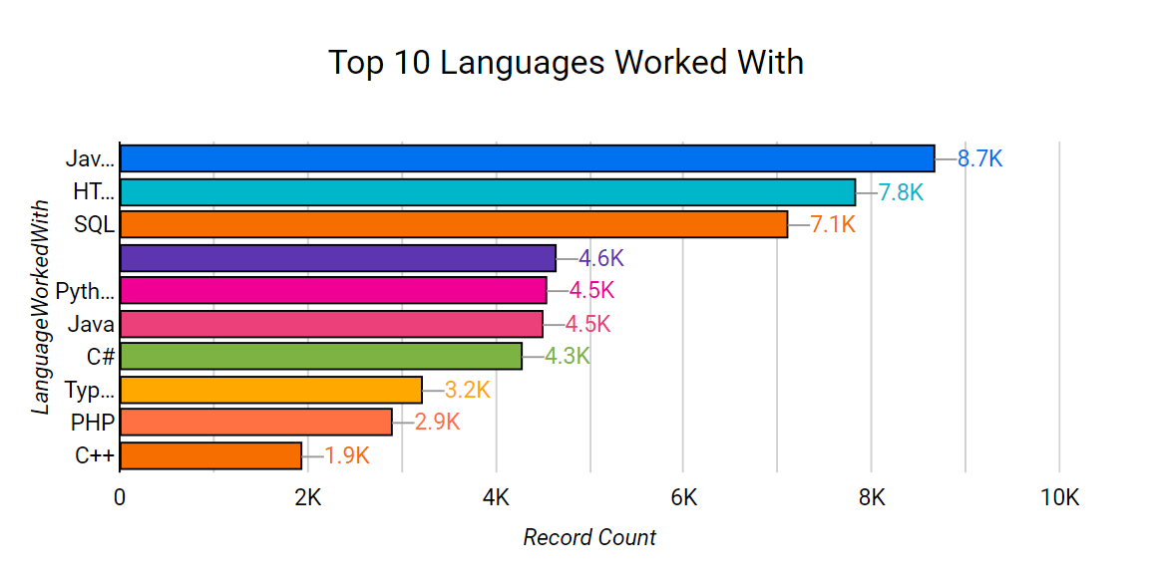
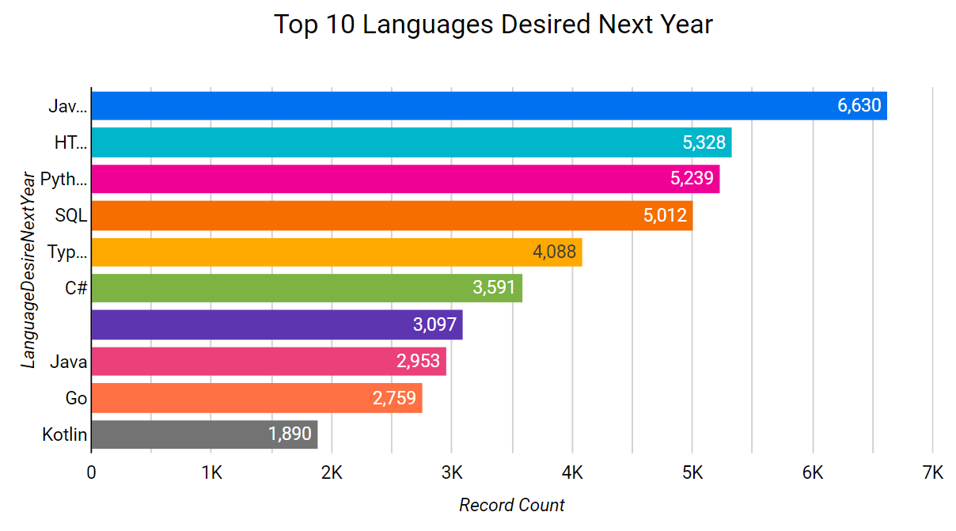
PROGRAMMING LANGUAGE TRENDS
Current Year
Next Year
<Bar chart of top 10 programming languages for the current year goes here.>

Slide 8
PROGRAMMING LANGUAGE TRENDS - FINDINGS & IMPLICATIONS
Findings
Javascript, HTML/CSS, SQL are currently the most used languages
Javascript & HTML/CSS will remain the most used languages in future coming years
Next year Python will surpass SQL
Implications
Javascript & HTML/CSS popularity as programming languages implies web developments skills is the most demanded tech skills , and explains the rise for Typescript
Python rise stems from the increasing demand of AI and machine learning skills
Even though SQL has slipped a little. It remains the relevant as vital skill even AI transform the data language.

Slide 9
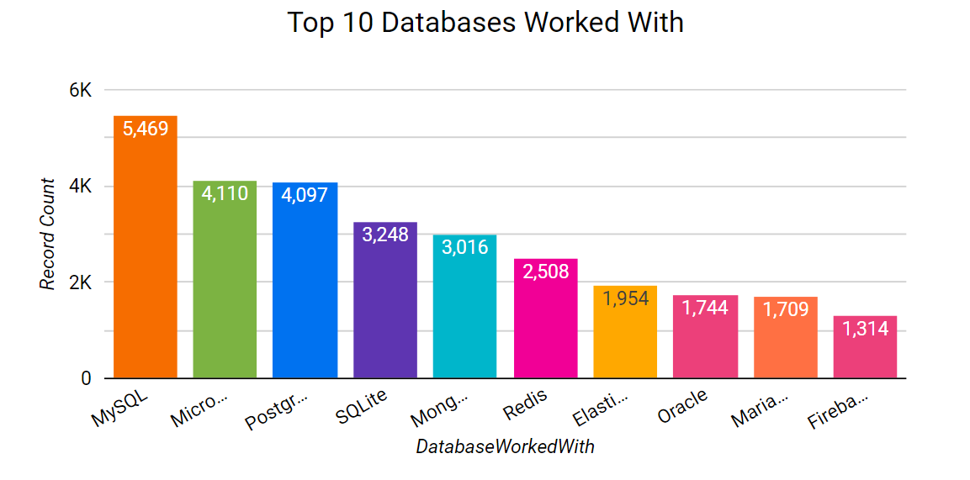
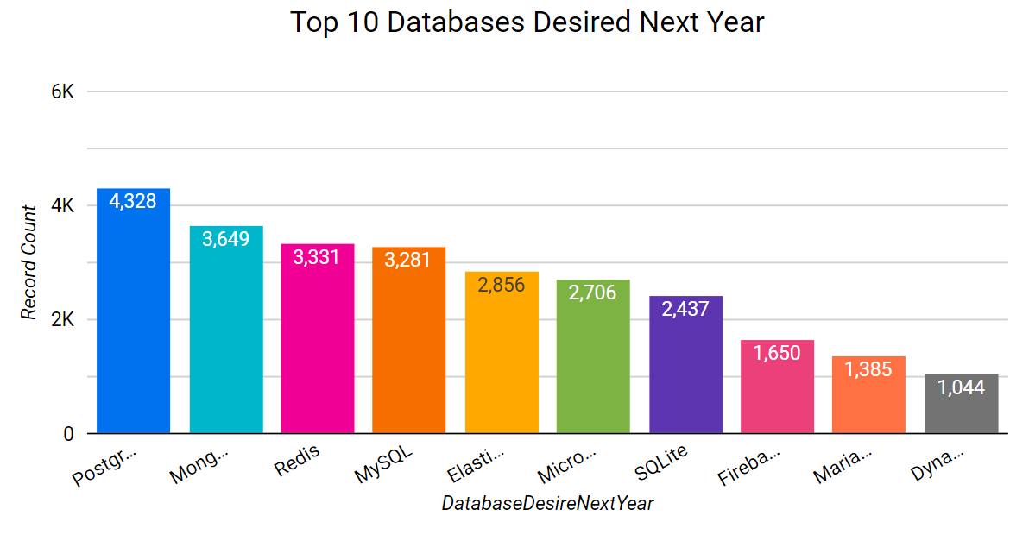
DATABASE TRENDS
Current Year
Next Year

Slide 10
DATABASE TRENDS - FINDINGS & IMPLICATIONS
Findings
MySQL is currently the leading relational database but despite its current dominance it is projected drop to fourth next year.
Microsoft SQL Server is a proprietary relational database management system developed by Microsoft, is currently second in demand but is predicted to drop to sixth place next year
PostgreSQL is a free, open-source relational database management system (RDBMS) , it’s projected to be the leading demanded database next year.
Implications
PostgresSQL becoming the leading database for next year, as it’s known for reliability, flexibility, and support of open technical standards. Designed for enterprise-level performance using SQL for queries and transactions . Potentially surpassing MySQL and Microsoft SQL Server in adoption and utilization
The potential drop from second to sixth for Microsoft SQL Server signals organisations to re-evaluate their database strategies and possible alternatives.
MySQL , regardless of its current dominance , next year it predicted to fall third place , directing organisations to start exploring possible alternatives

Slide 11
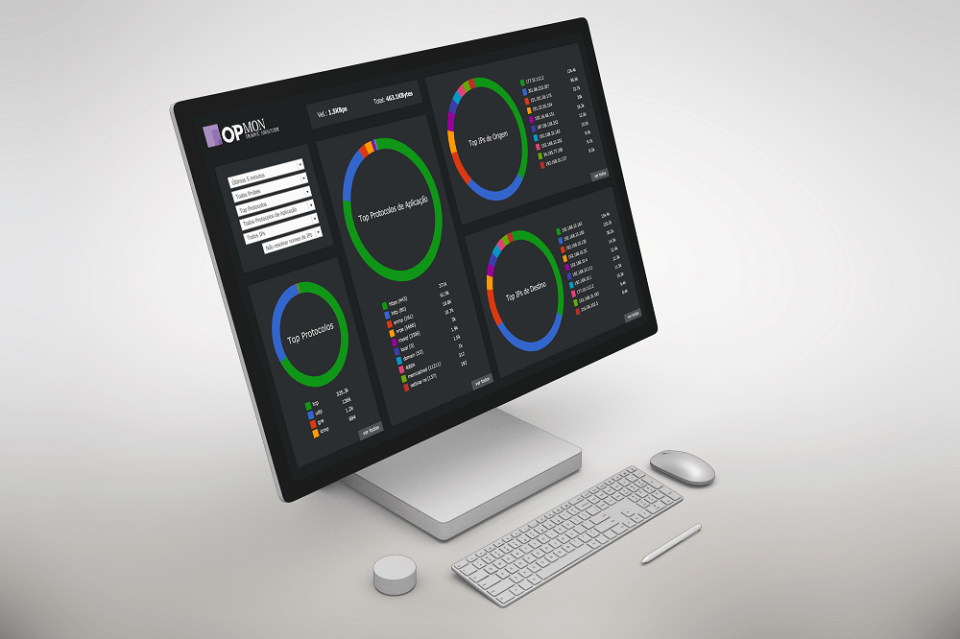

DASHBOARD
<Lukea-lab/Capstone-Project: Google Looker studio

Slide 12
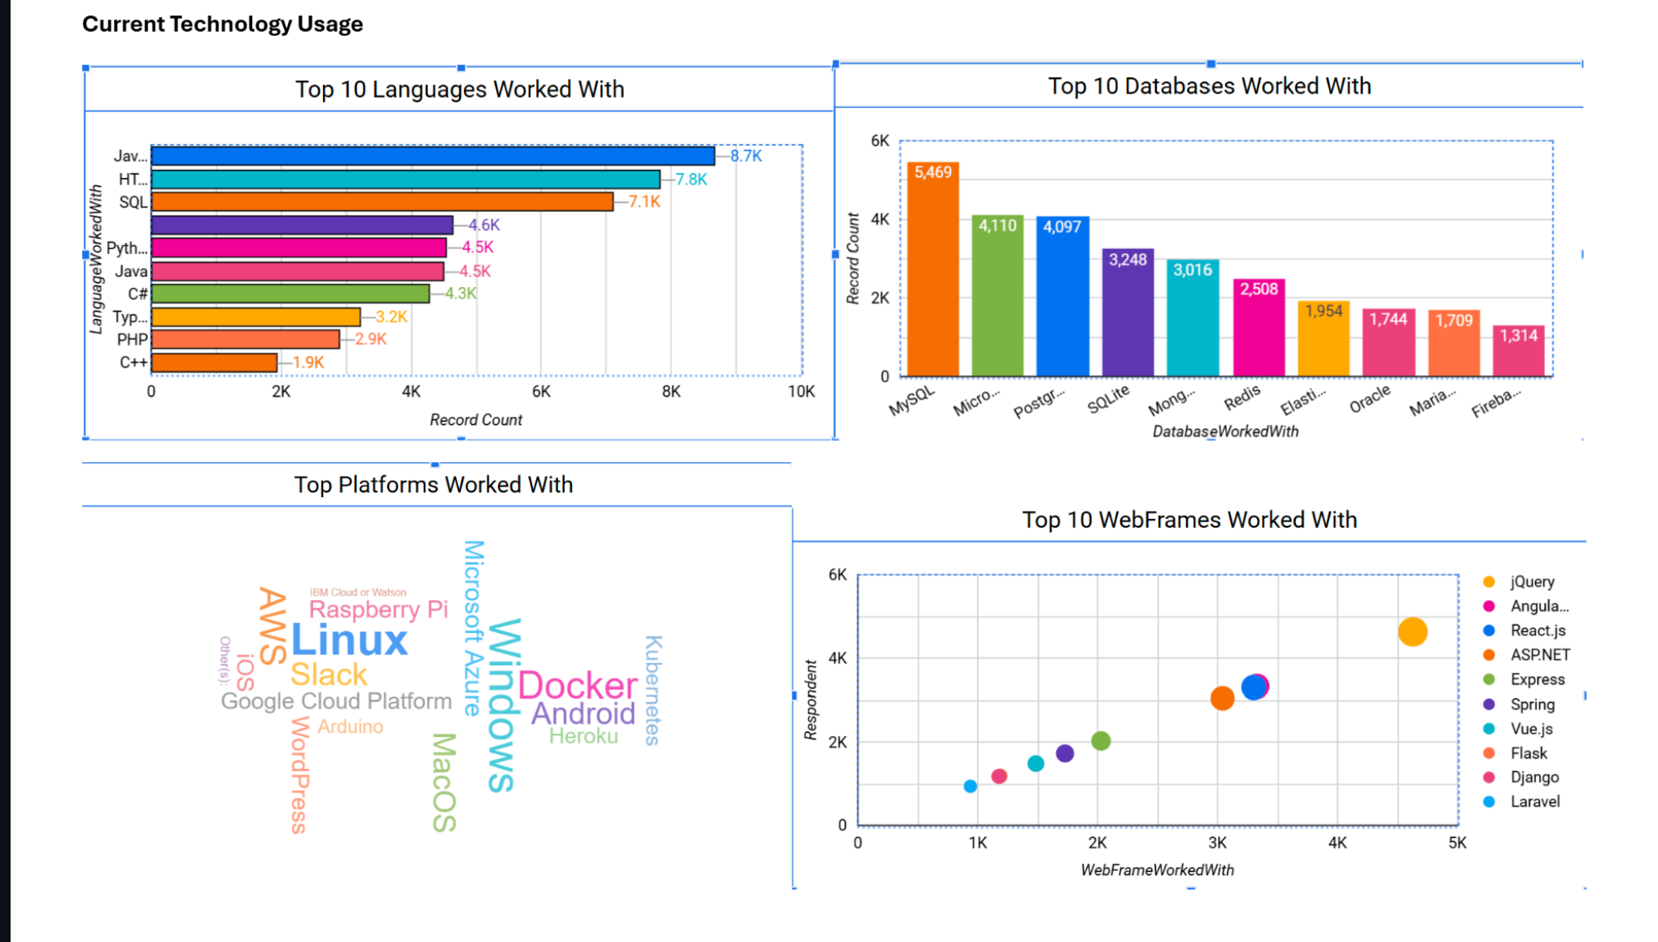
DASHBOARD TAB 1

Slide 13
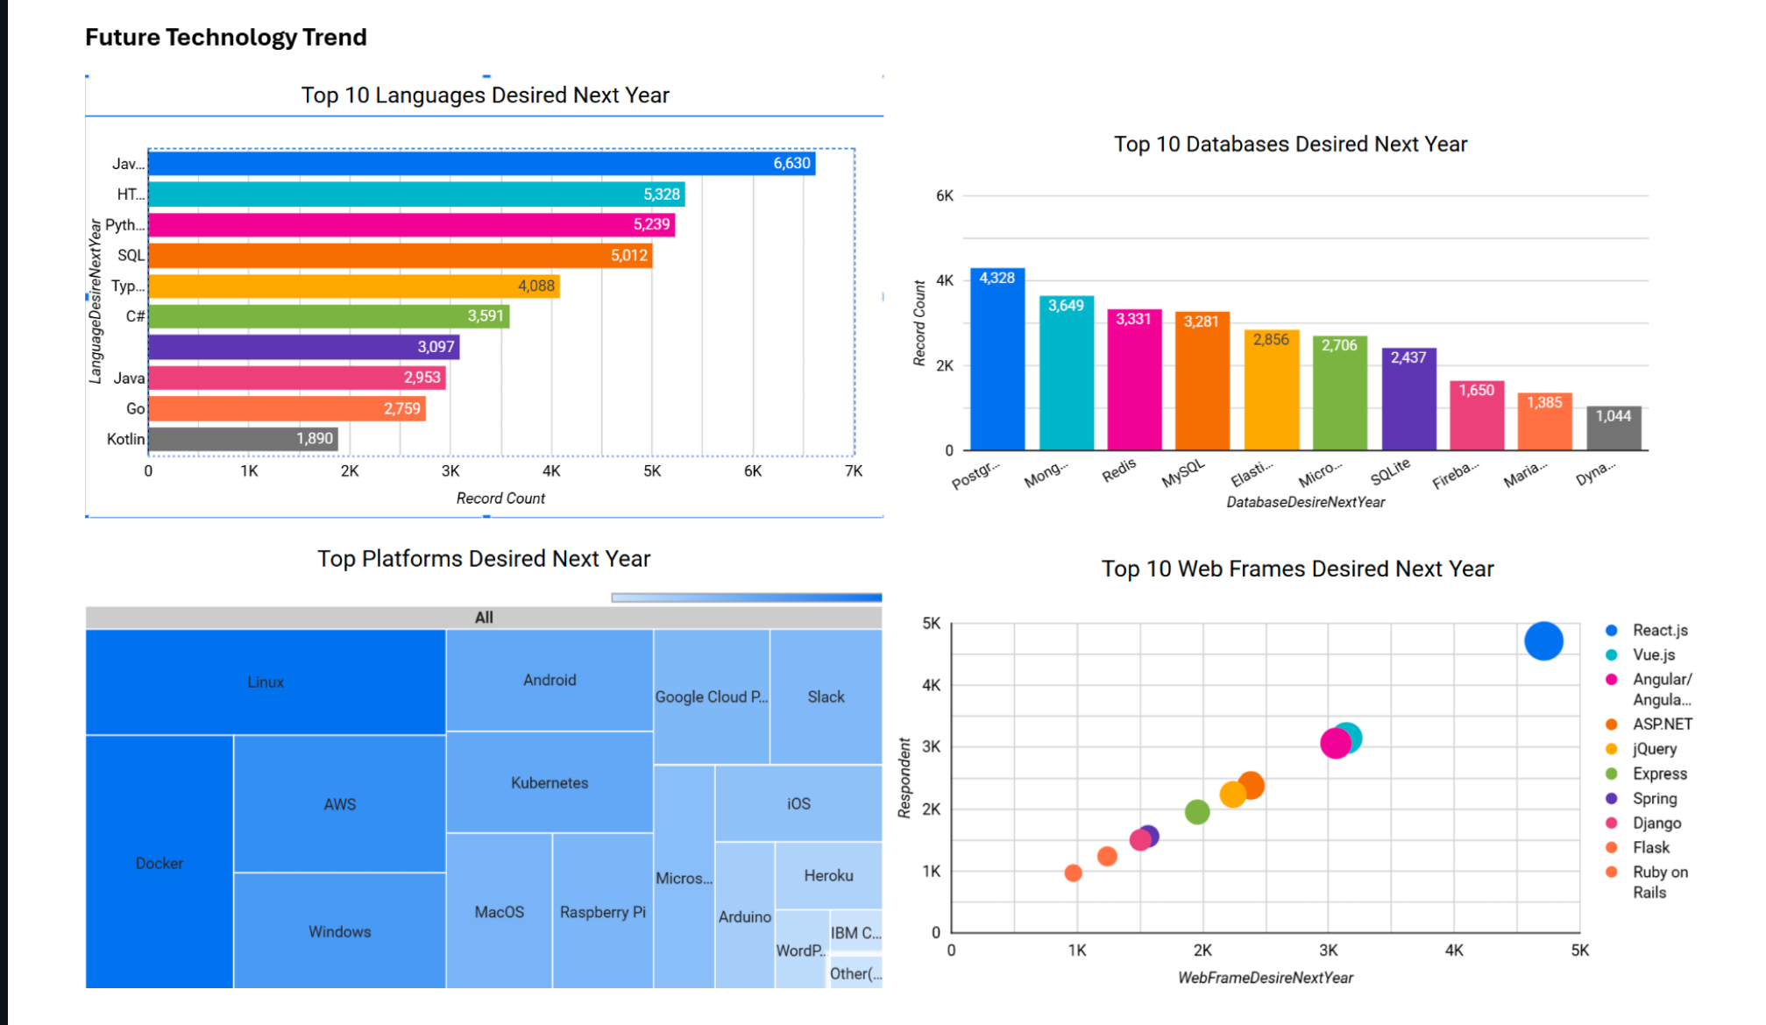
DASHBOARD TAB 2

Slide 14
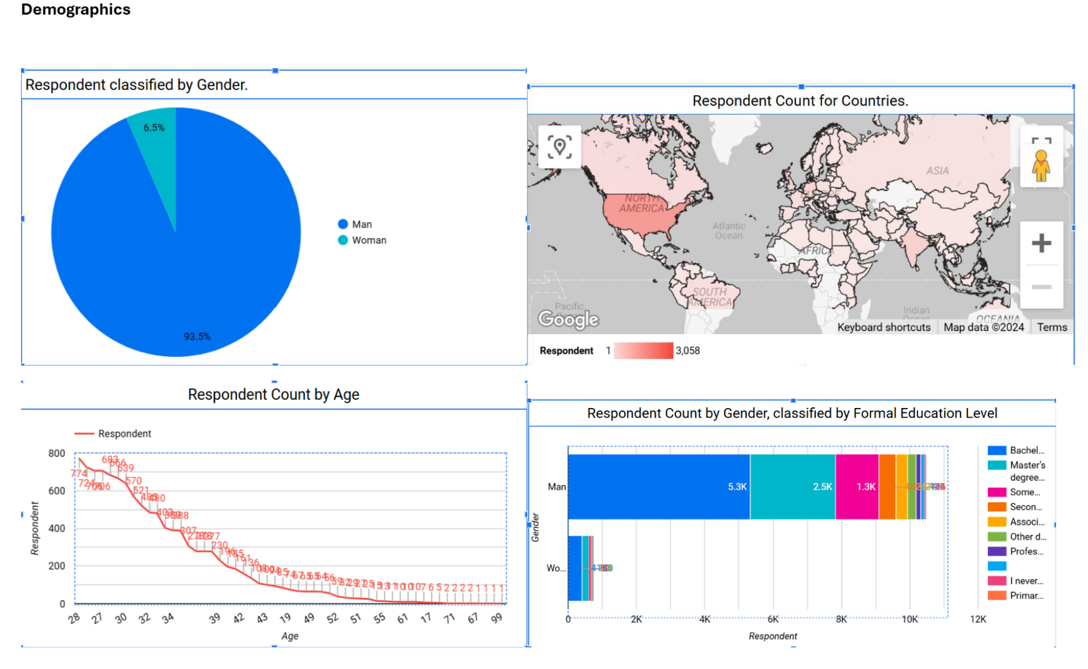
DASHBOARD TAB 3

Slide 15

DISCUSSION

Slide 16
OVERALL FINDINGS & IMPLICATIONS
Findings
It was sought-after majority of those in the IT sector have a Bachelor’s degree, hinting its value as a primarily qualification.
Web development languages being the clear most sought-after programming skill set , highlighting the technological focus right now
The IT sector is mostly comprised of younger professional under the age of 40, which could be believe to the fuel the innovation and progress in the industry
Most respondents desire to learn PostgreSQL and React JS next year
Implications
Its important for data professionals to have a diversify skill set, by proficient in both NoSQL and SQL databases
Web development being and continuing to be a lucrative skill , indicates the importance of investing and advancing one’s expertise in this area.
Less developed countries, not having the necessary resources for IT/Tech training and education, address this is a possible way to further grow the industry

Slide 17

CONCLUSION
Programming Language Trend –JavaScript & HTML/CSS are the current and future in demand languages
Database Trend – Analysis indicates that PostgreSQL will replace MySQL as the most demanded database.
Platform Trend- There no real change in the most demanded platforms
Web Framework Trend – the projected rise in for React.JS indicates the growing importance of front-end development skills.
Demographic Trend- It is made evident that the respondents were mainly male and under the age 40 years old

Slide 18

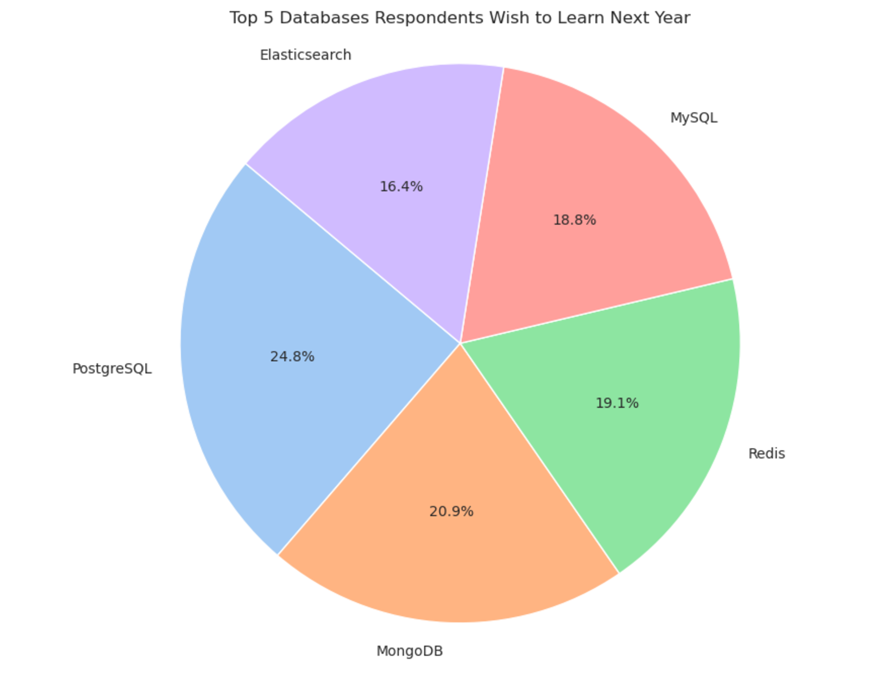
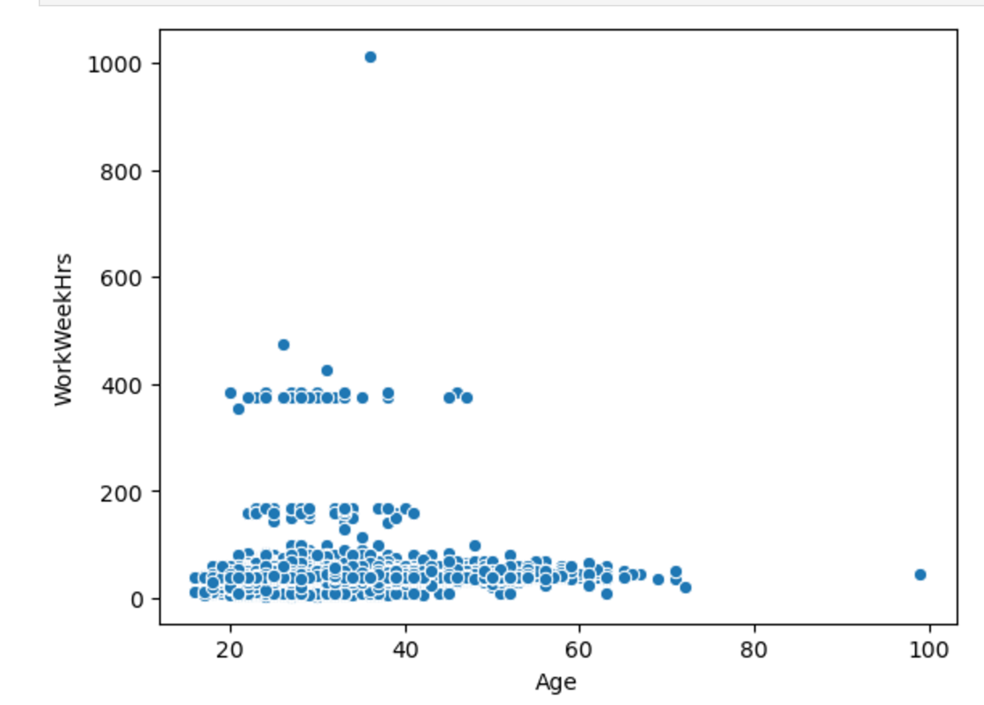
APPENDIX
.

Slide 19
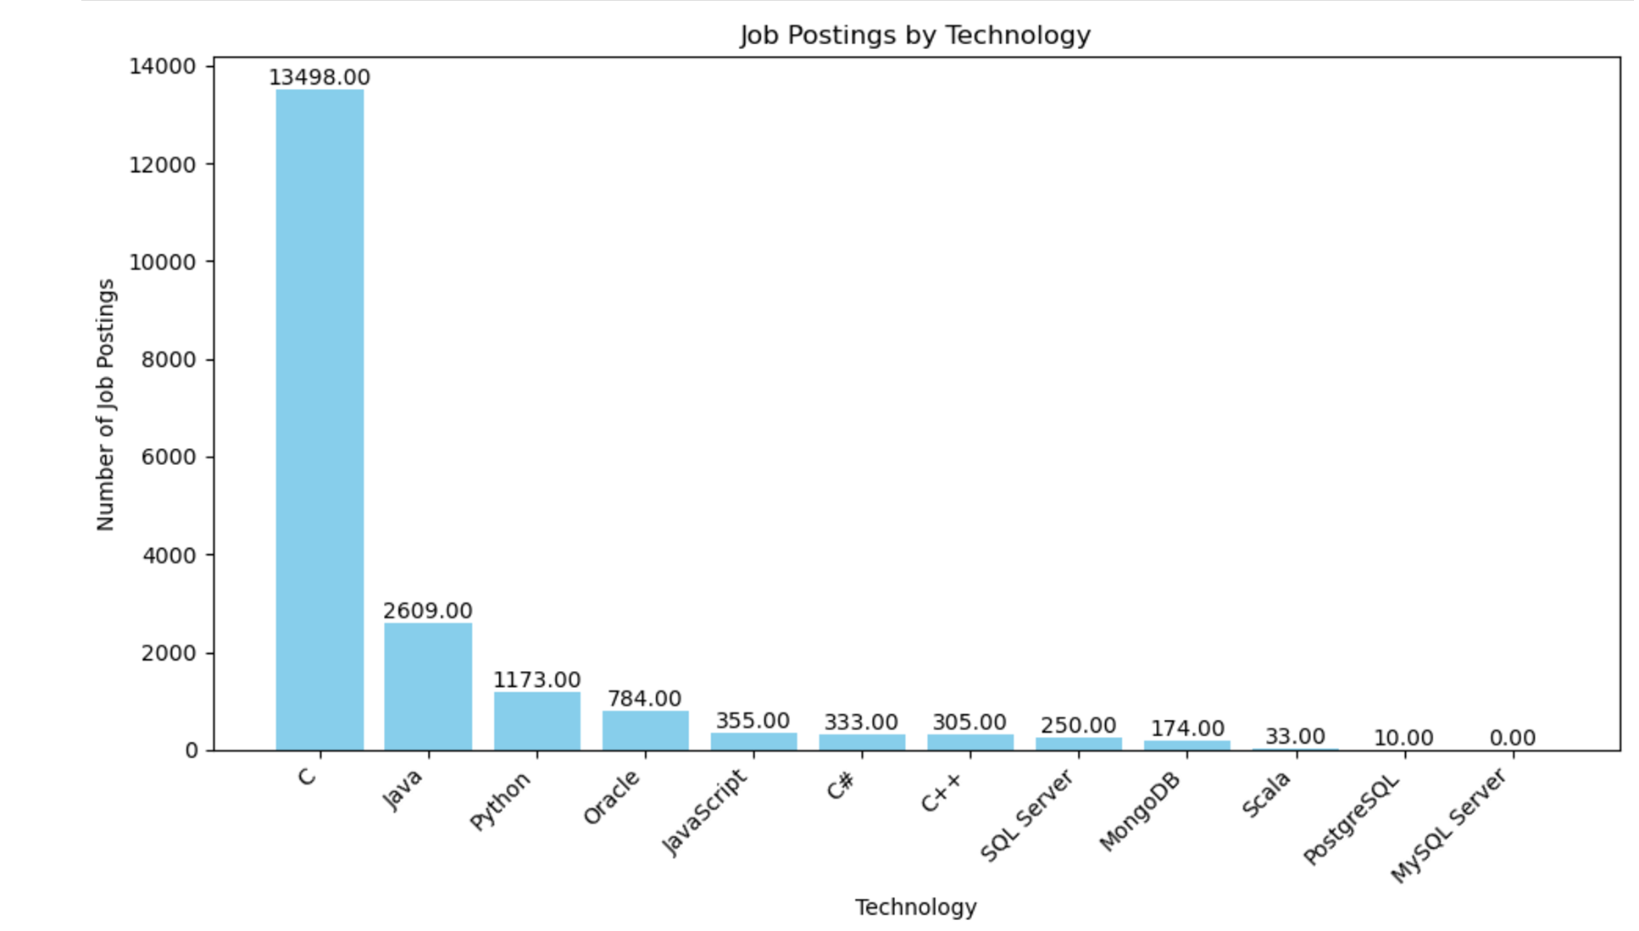
JOB POSTINGS
Bar chart displaying the Job Posting by Technoloy collected via Github API

Slide 20
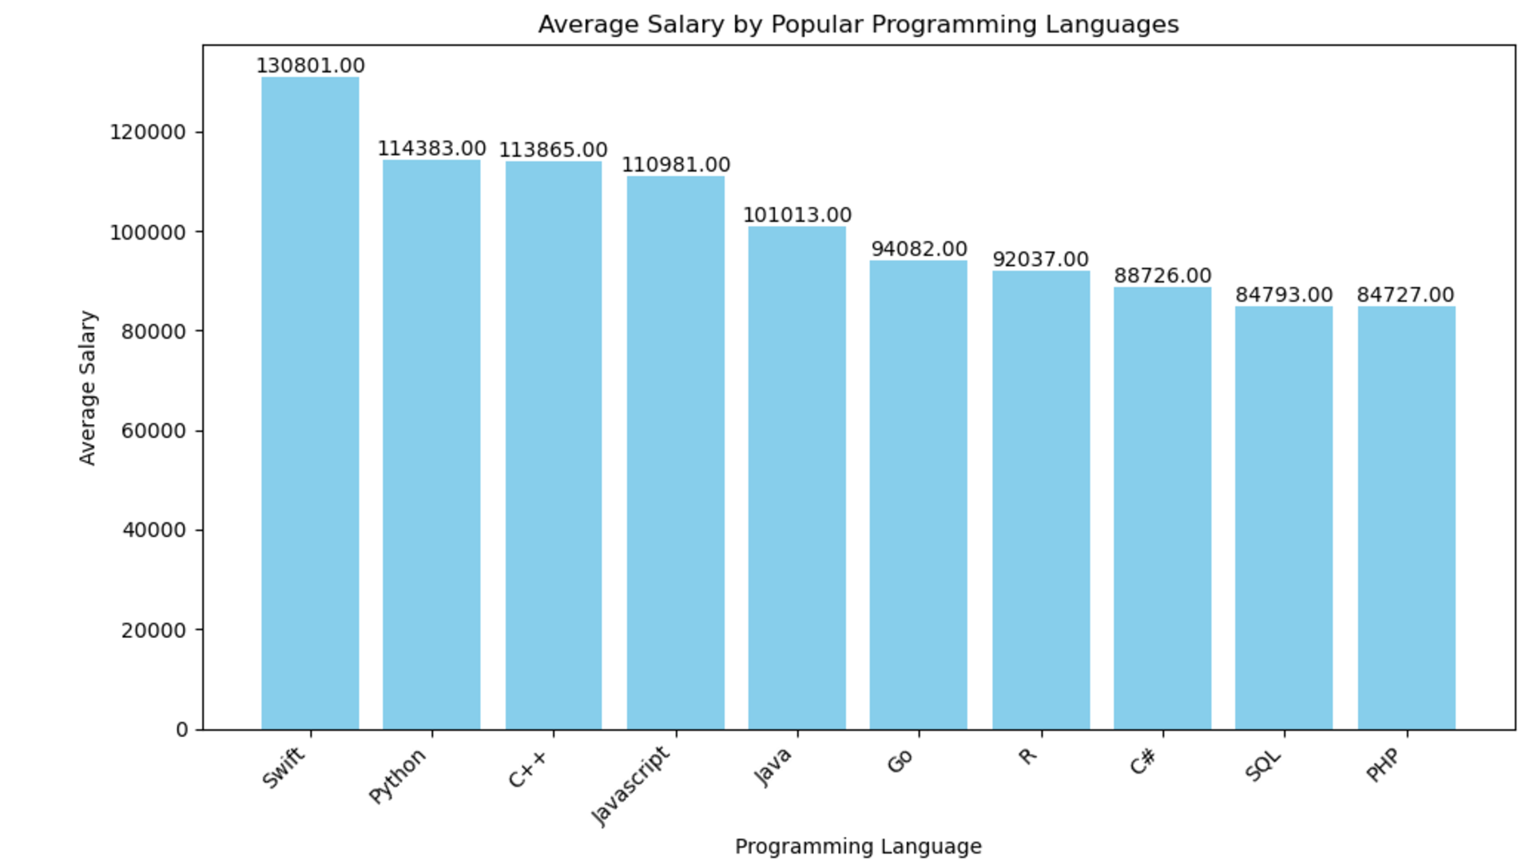
POPULAR LANGUAGES
Bar chart displaying popular languages and their average annual salary. This data set is the result of web scraping Github jobs data , which was saved a csv file format.

